Slide 1
OPERATIONS RESEARCH PRESENTATION EISHA MAZHAR 17K-3730 GR2

Slide 2
DIJKSTRA’S ALGORITHM FLOYD WARSHALL’S ALGORITHM FORD’S ALGORITHM
SHORTEST PATH ALGORITHM

Slide 3
DIJKSTRA’S ALGORITHM

Slide 4
DIJKSTRA’S ALGORITHM
Example of problems that can be modeled using graphs with weights assigned to their edges:
Airline flight times
Telephone communication costs
Computer networks response times
Fastest way to get to school by car
Finding the cheapest flight home

Slide 5
DIJKSTRA’S ALGORITHM
Basics:
For given source vertices it finds the lowest cost for each other vertices.
It doesn’t cater negative costs.
It can be used to find lowest cost for particular destination by stopping the algorithm in between.

Slide 6
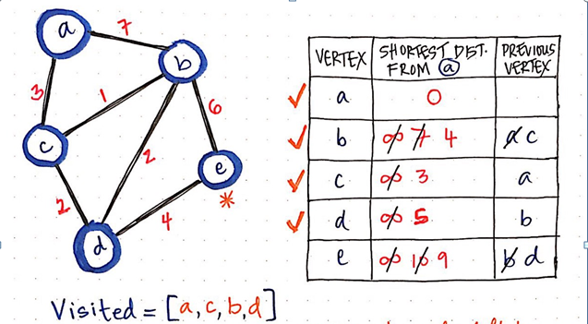
DIJIKSTRA’S ALGORITHM

Slide 7
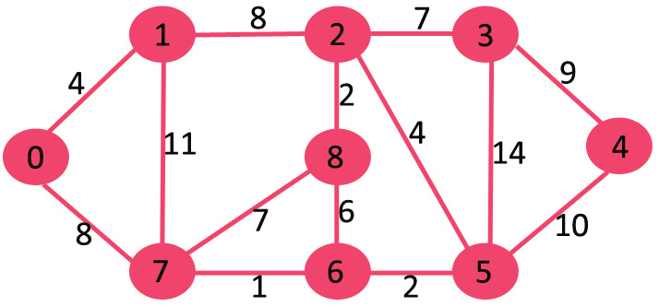
DIJIKSTRA’S ALGORITHM

Slide 8

DIJKSTRA’S ALGORITHM

Slide 9
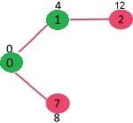
DIJKSTRA’S ALGORITHM

Slide 10
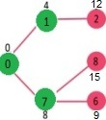
DIJKSTRA’S ALGORITHM

Slide 11
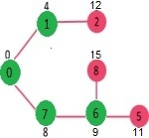
DIJIKSTRA’S ALGORITHM

Slide 12
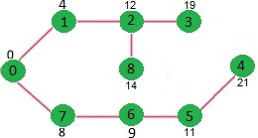
DIJIKSTRA’S ALGORITHM

Slide 13
DIJKSTRA’S ALGORITHM
NOTE:
If we are interested only in shortest distance from source to a single target, we can end when the picked minimum distance vertex is equal to target.

Slide 14
DIJKSTRA’S ALGORITHM
NOTE:
If we are interested only in shortest distance from source to a single target, we can end when the picked minimum distance vertex is equal to target.

Slide 15
DIJKSTRA’S ALGORITHM
WHY DOESN’T DIJIKSTRA HANDLE NEGATIVE WEIGHTS?
Dijkstra relies on one "simple" fact: if all weights are non-negative, adding an edge can never make a path shorter.... And adding some positive number X to all the edges just to make them positive doesn't result in correct answer.

Slide 16
FLOYD WARSHALL’S ALGORITHM

Slide 17
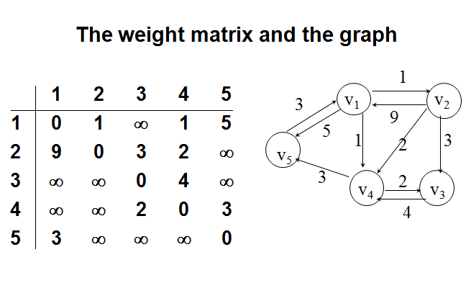
FLOYD’S ALGORITHM

Slide 18
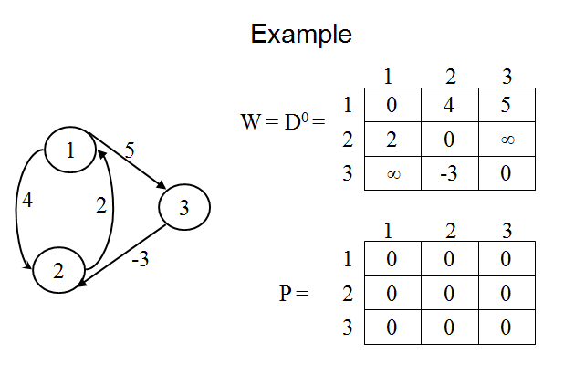
FLOYD’S ALGORITHM

Slide 19
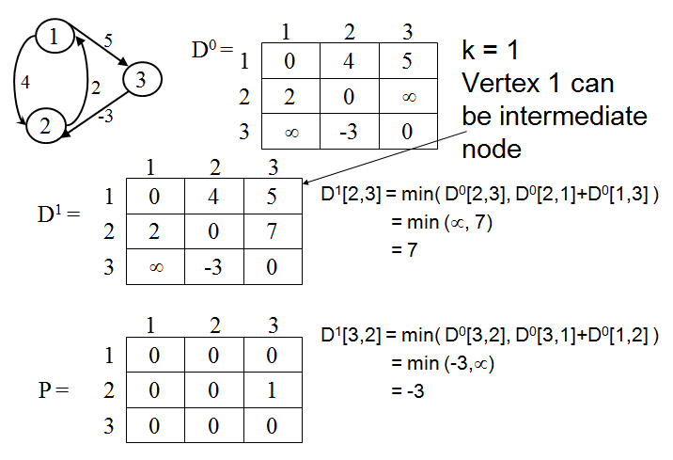
FLOYD’S ALGORITHM

Slide 20
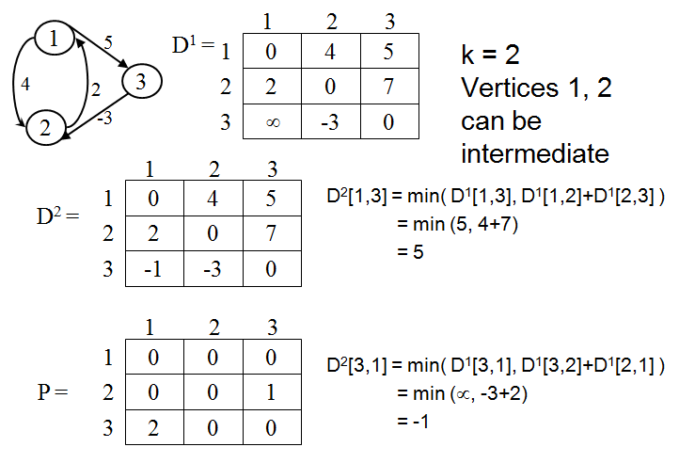
FLOYD’S ALGORITHM

Slide 21
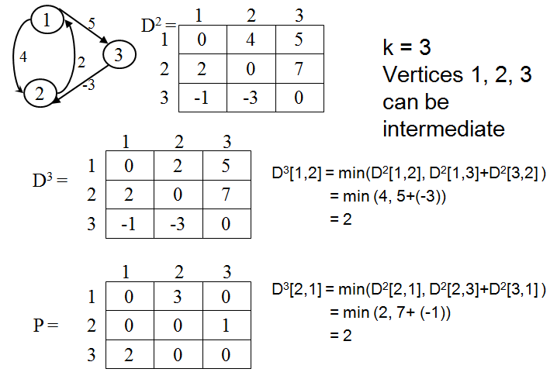
FLOYD’S ALGORITHM

Slide 22
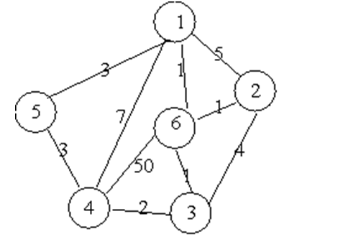
FLOYD’S ALGORITHM

Slide 23
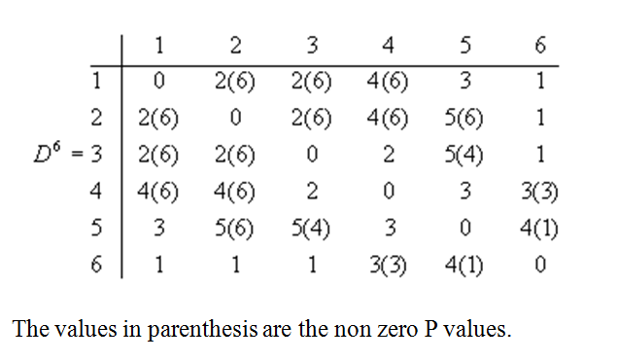
FLOYD’S ALGORITHM

Slide 24
FLOYD’S ALGORITHM
The End!

